Slide 1
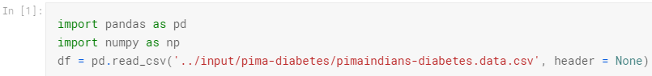
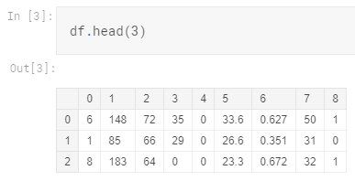
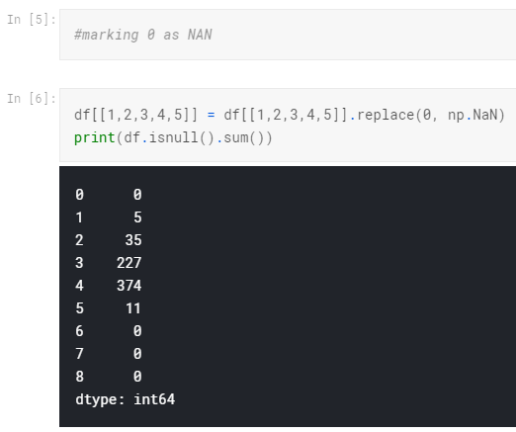
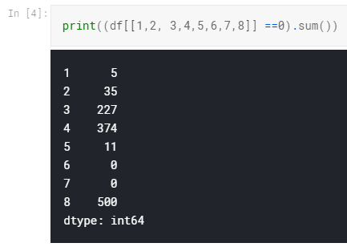
https://www.kaggle.com/kunalchamoli/handling-missing-data

Slide 2
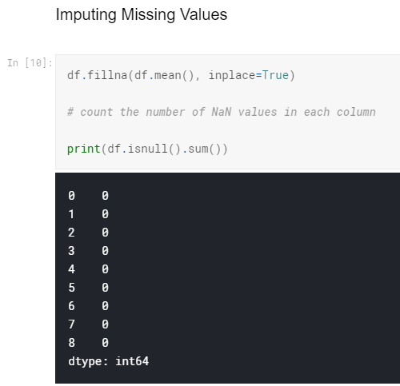

Slide 3
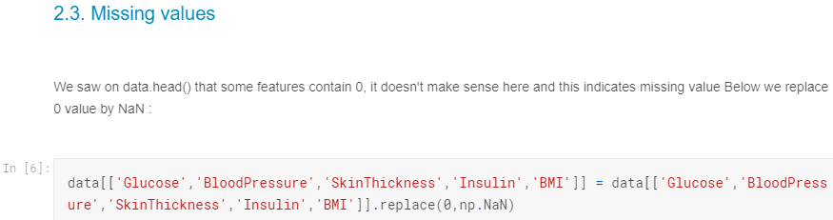

Slide 4
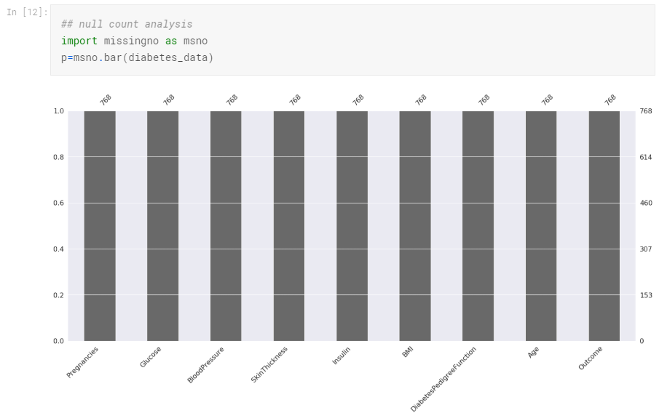

Slide 5
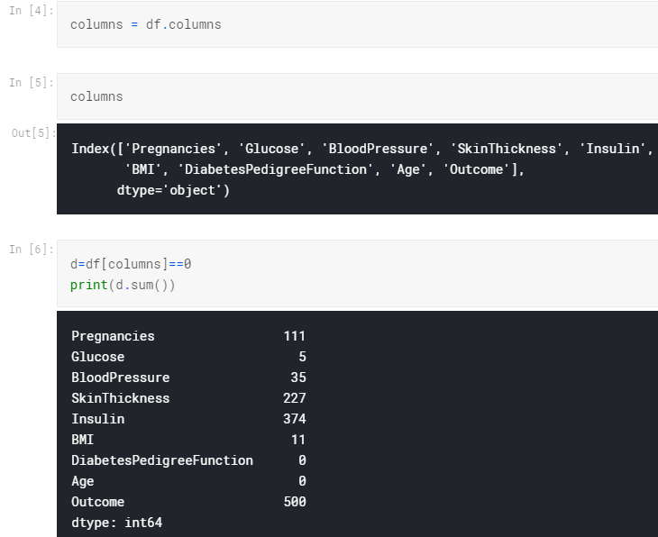

Slide 6
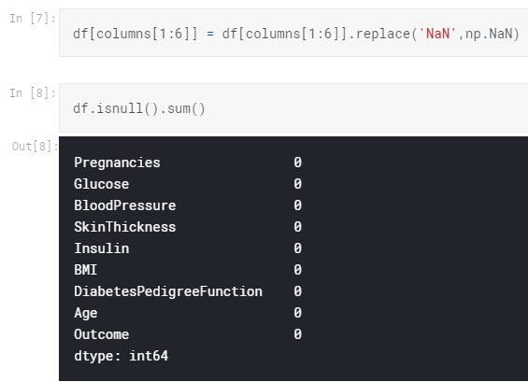
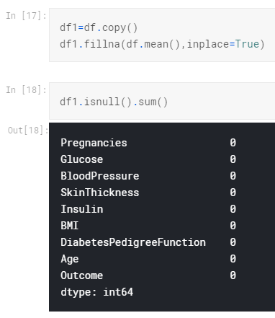

Slide 8
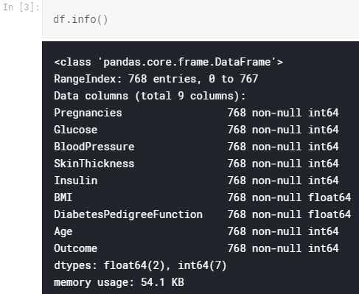
https://www.kaggle.com/shashankasubrahmanya/missing-data-imputation-using-regression
A simple df.info() is ran for a quick and abstract check for missing data in any of the variables. This lists the number of non-null values and the datatype of each variable.

Slide 9
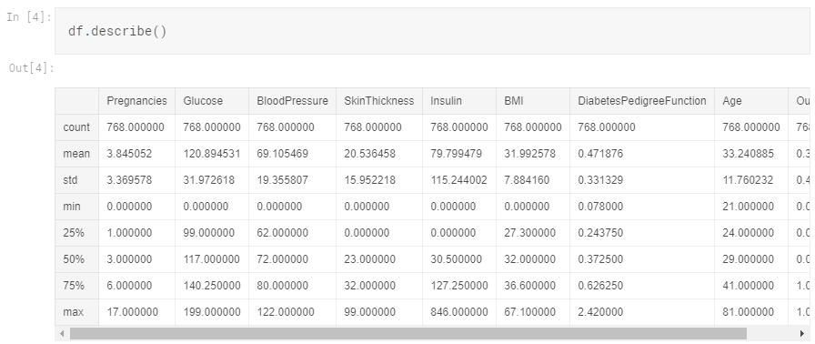
None of the variables seem to have any missing value based on our above observation. But there's more to it than what meets the eye. df.describe() which gives the Five Number Summary would show that some variables have 0.0 as their minimum value which would be meaningless in their case. Plasma glucose concentration, Diastolic blood pressure, Triceps skinfold thickness, 2-Hour serum insulin and Body mass index cannot be zero.
Imagine BMI to be zero. That would be a disaster!
On the contrary, Pregnencies can be zero because either that person is a female who has not had a baby yet.

Slide 10
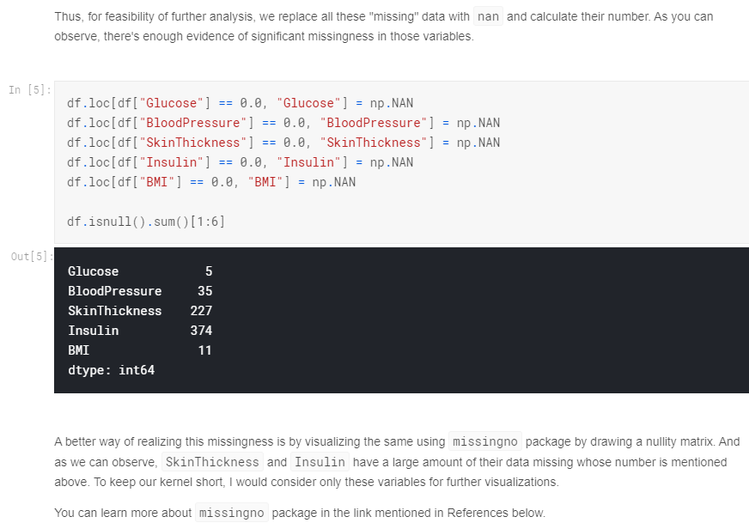

Slide 11
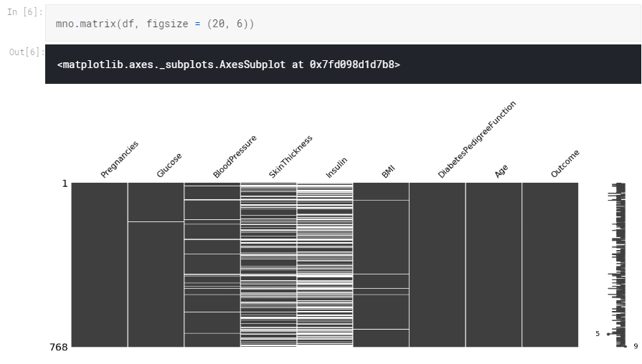

Slide 12
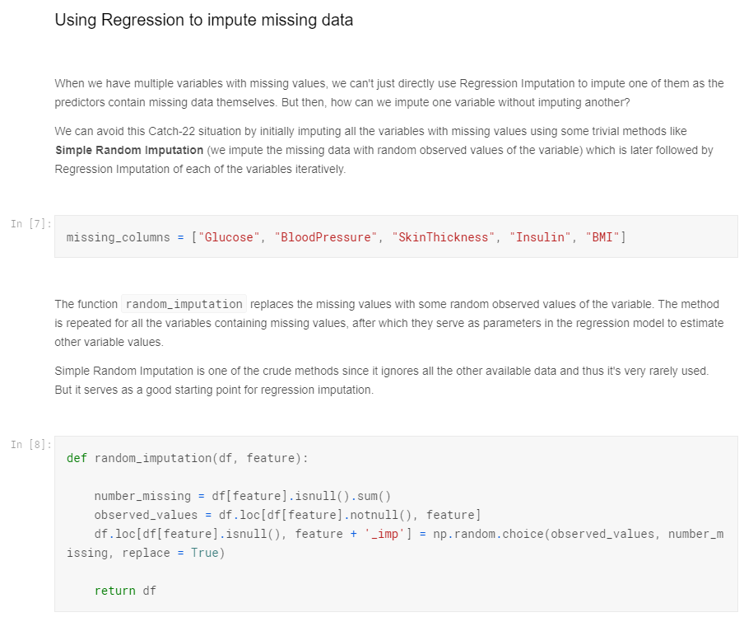

Slide 13
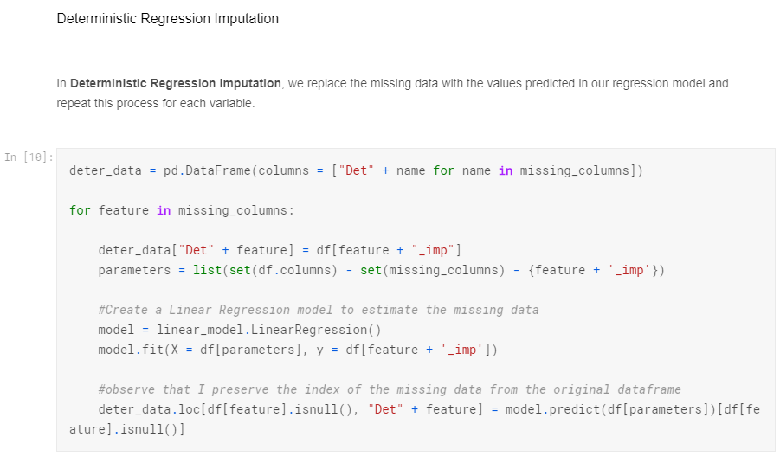

Slide 14
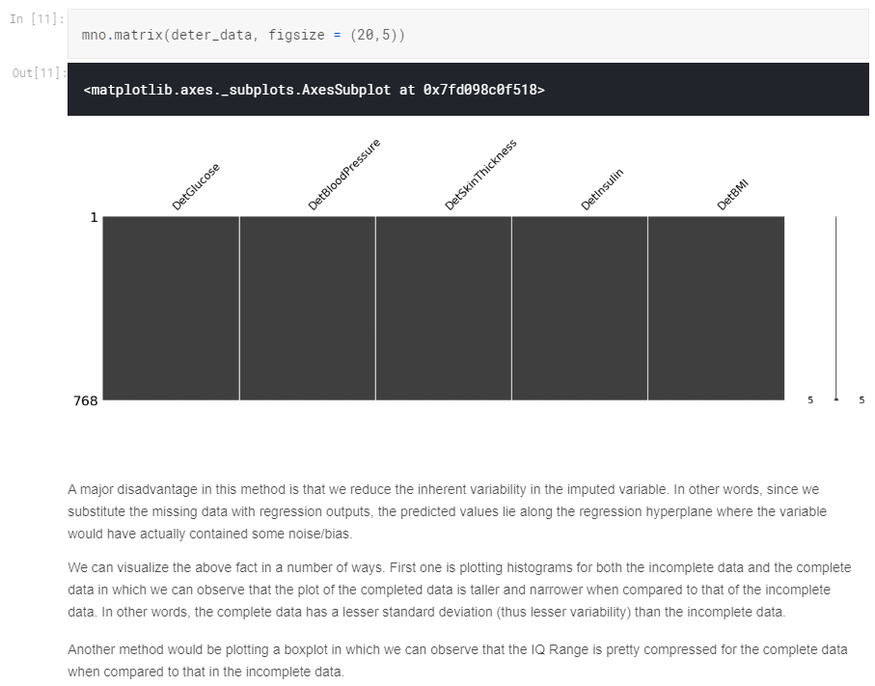

Slide 15
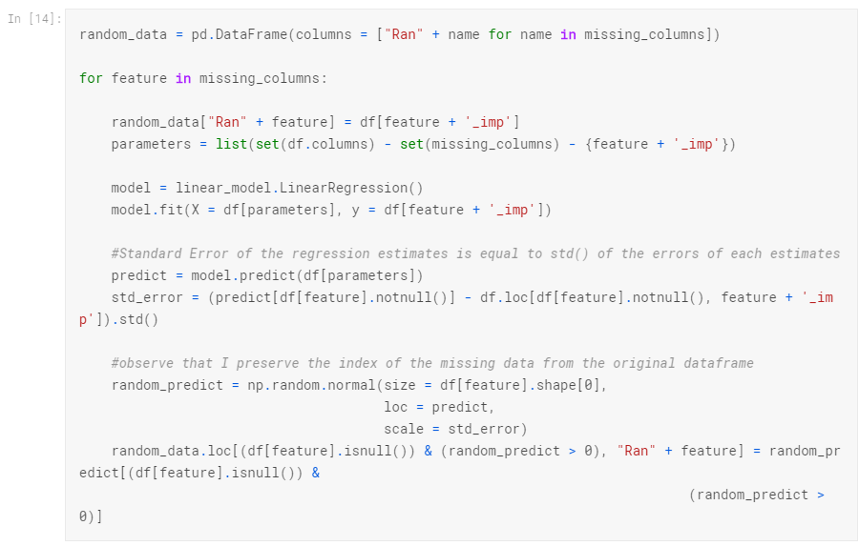
Stochastic Regression Imputation
To add uncertainty back to the imputed variable values, we can add some normally distributed noise with a mean of zero and the variance equal to the standard error of regression estimates . This method is called as Random Imputation or Stochastic Regression Imputation

Slide 16
When we introduce this Gaussian noise we may end up imputing some negative values for the missing data due to the spread of the distribution for a particular pair of mean and standard deviation. But, as per our discussion earlier, there might be some variable whose values can never be zero. For example, a negative value for Insulin concentrations would be meaningless.
We can avoid this situation by retaining the values introduced by simple random imputation which is discussed above. This apparently reduces the variability that we introduce, but it's something we have to deal with, especially in case of these variables whose values are restricted to certain parts of the real number line.

Slide 17
https://www.iriseekhout.com/missing-data/missing-data-methods/imputation-methods/
Single imputation methods
Mean imputation
Regression imputation
Matching methods
Multiple imputation

